Slide 1
Applying EU Structural & Investment Funds to reduce health inequalities
Stecy Yghemonos
Health and Social Investment Manager

Slide 2
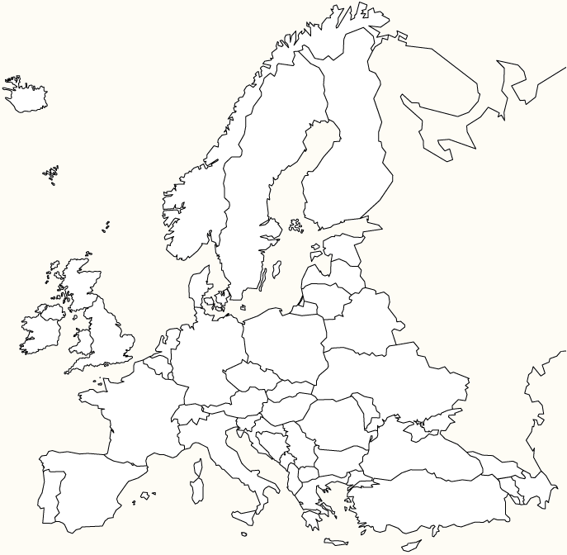
EuroHealthNet
European Network of health promotion and disease prevention bodies
Over 40 member/partner organisations Italy: Veneto and Tuscany regions
Focus on reduction of health inequalities
Coordinator of / involved in various EU projects
e.g. Joint Action on Health Inequalities
Making the links between policy development processes within MS and at EU level
EU Cohesion Policy

Slide 3
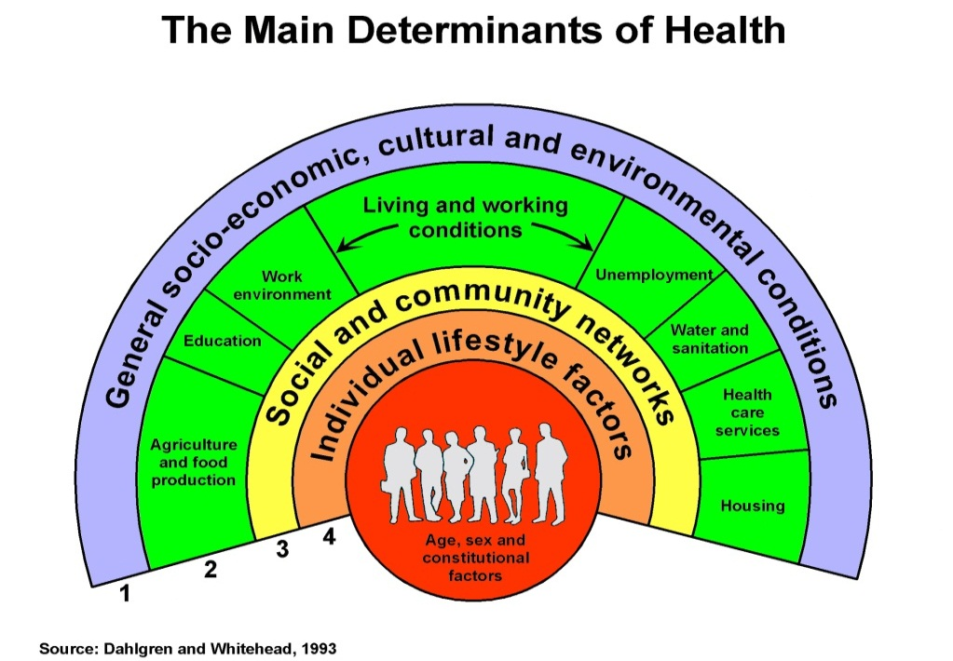
The Social Determinants of Health Approach
The EU 2020 Strategy
→ Jobs
→ Education
→ Social Inclusion
→ Environment
→ Research/Innovation
+
Loads of EU cooperation mechanisms, programmes and funding streams
Notes:
While the health sector can treat ill health and peomote health but it does not shape people’s health

Slide 4
The way we work

Slide 5
Our Mission
→ Contribute to Health Equity between and within EU countries
→ Combat Non-Communicable Diseases
→ Health Promotion and Disease Prevention for sustainable health systems
Project Outcomes
Advocacy
Evidence
Share good practices among Member States
Recommendations
Partnerships
Health across policies
Inform policy makers
Communication (newsletter, websites)
→Implement/Document
→Raise awareness

Slide 6
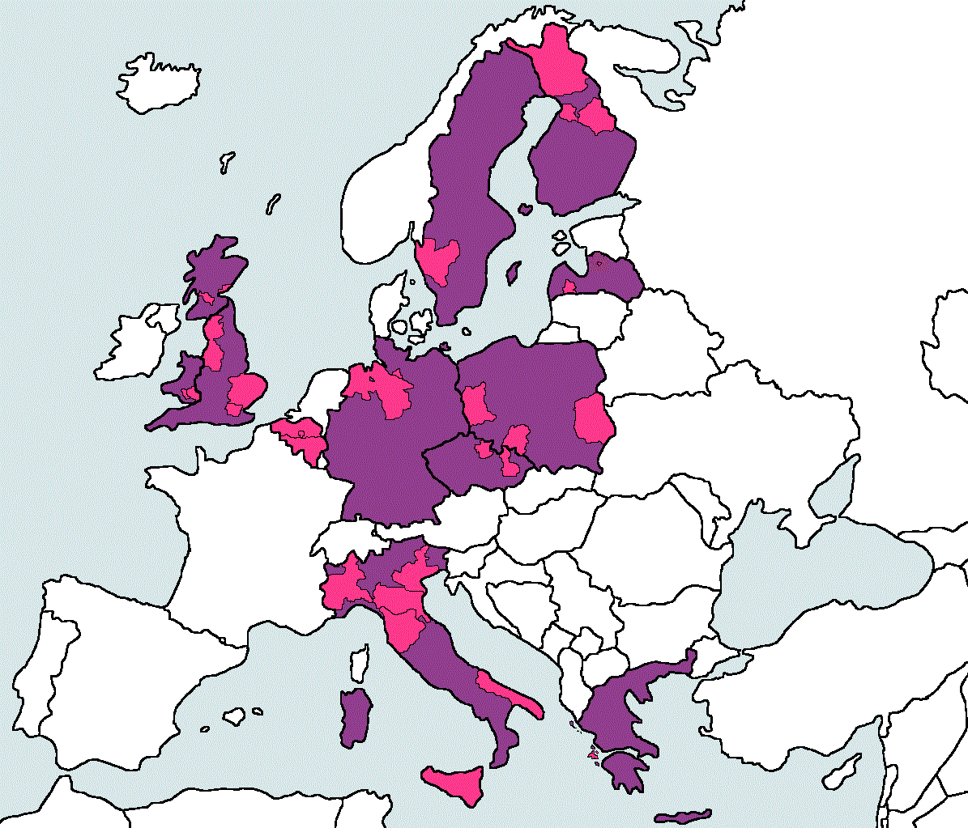
Equity Action - Regional Work Strand
EuroHealthNet coordinated:
Regional network of 30 regions in 10 MS
Regional Case Studies & Structural Funds Review
SF Review, by regions and national partners Aim: Develop knowledge and gather evidence on how EU Structural Funds can be used to reduce health inequalities
www.health-inequalities.eu
Notes:
Started in February 2011 – ended in 2014 (3 years)

Slide 7
EU Cohesion Policy
‘Regional Policy of the EU’
Main objective: to reduce the significant gap between less-favoured regions and affluent ones in Europe
Supports: job creation, competitiveness, economic growth, improved quality of life and sustainable development
Focus: Economic, Social & Territorial disparities
EU Structural and Investment Funds
Financial Mechanism to implement Cohesion Policy
Renewed every 7 years (current period: 2014-2020)

Slide 8
Budget 2014-2020
325 billion euros
More than 1/3 of total EU budget
2nd largest EU financing mechanism
Vote in Parliament on 18-21 Nov 2013 (after more than a year of negotiations)

Slide 9
11 Themes (2014-2020)
Research & Innovation
Communication Technologies
SMEs
Low-carbon economy
Climate change
Environment
Sustainable Transport
Employment
Social Inclusion & Poverty
Education, Skills & Life-long learning
Capacity Building
Europe 2020:
Smart, Sustainable & Inclusive Growth
Notes:
The Regulation introduces macroeconomic conditionalities and includes ex-ante conditionalities. These are conditions that must be in place before funds are disbursed, to ensure that the effectiveness of EU funding is not undermined by unsound macro-fiscal policies. This includes ensuring that measures that receive Structural Funds contribute to existing government policy frameworks or strategies. The ex-ante conditionalities include thematic conditionalities, such as health, early school leaving, active and healthy ageing, access to employment and Roma inclusion, and horizontal conditionalities, such as anti-discrimination and gender equality. Various ex-ante conditionalities have been proposed that are of relevance to public health actors and that could have an impact on reducing health inequalities.
Conditionality will also take the form of ex-post conditions that will make the release of additional funds contingent on performance.
Thematic priority eleven relates to Capacity Building. This offers opportunities to build expertise within the public health sector to address the social determinants of health and health inequalities.
These funds can for example be applied to build capacities of administrators and public health professionals to monitor health inequalities, incorporate health equity in the design and implementation of programmes and maximize the health equity impacts of initiatives taken within and beyond their sectors.

Slide 10
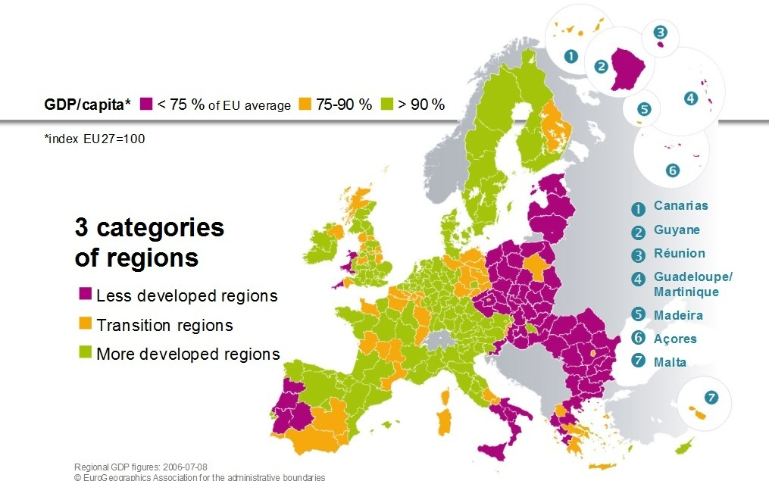
European Regions
Notes:
New categories for regions: Less developed regions, transition regions, more developed regions
‘Less developed’ regions: these are regions where GDP per capita is below 75% of the EU average.
‘Transition’ regions: These are regions where GDP per capita is between 75% and 90% of the EU average.
‘More developed’ regions: These are regions where GDP per capita is above 90% of the average.

Slide 11
Budget Cohesion Policy 2014-2020

Slide 12
Funding Programmes
Economic change, regional development, enhanced competitiveness and territorial co-operation
Funding of ‘hard projects’
Enhancing access to employment and participation in the labour market, and reinforcing social inclusion
Funding of ‘soft projects’
Environment and trans-European transport networks
MS with a GNI of less than 90% of the EU average
Agriculture and Rural Development
Maritime and Fisheries
ERDF
ESF
CF
EAFRD
EMFF
Notes:
Targeting key growth sectors
Focus ERDF (around €100 billion): innovation and research, digital agenda, SMEs and low-carbon economy. The ERDF supports programmes addressing regional development, economic change, enhanced competitiveness and territorial co-operation throughout the EU. Funding priorities include modernising economic structures, creating sustainable jobs and economic growth, research and innovation, environmental protection and risk prevention. Investment in infrastructure also retains an important role, especially in the least-developed regions
Focus ESF (around €70 billion ): employment and mobility, training and life-long learning, better public administration, education and social inclusion → At least 20% of the ESF in each Member State will have to be used to support this objective. The ESF aims to support efforts to increase the adaptability of workers and enterprises, enhance access to employment and participation in the labour market, reinforce social inclusion by combating discrimination and facilitating access to the labour market for disadvantaged people, and promote partnerships for reform in the fields of employment and inclusion.
Focus CF (around €66 billion): Trans-European transport links and key environmental infrastructure projects

Slide 13
Structural Funds in Italy (1)
Budget 2014-2020
€32.8 billion
4 strategic objectives divided into 15 priorities:
Developing an innovation-friendly business environment.
Putting in place high-performance infrastructures and efficient management of natural resources.
Increasing labour market participation, promoting social inclusion and improving the quality of human capital.
Supporting the quality, effectiveness and efficiency of
the public administration.

Slide 14
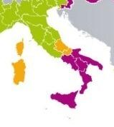
Structural Funds in Italy (2)
Total allocations of Cohesion Policy 2014-2020 (billion € , current prices)
European Territorial Cooperation | Less developed regions | Transition regions | More developed regions | Youth Employment Initiative | Total
1.1 | 22.3 | 1.1 | 7.7 | 0.567 | 32.8
Notes:
Total: 28.8 billion for 2007-2013
Less developed regions (Campania, Puglia, Basilicata, Calabria and Sicilia)

Slide 15
How can EU Structural & Investment Funds be used to reduce health inequalities?

Slide 16
Examples identified
Systematic approaches
Health (equity) as a selection / evaluation criteria
Health (equity) as a cross-cutting SF theme
Leveraging existing approaches
Projects and Programmes
… Specifically focused on reducing health inequalities
… Addressing underlying determinants of health by:
Promoting social inclusion and combating poverty
Promoting employment and supporting labour mobility
Investing in education and life-long-learning
Urban regeneration and pollution
Stimulating production of innovation products that benefit vulnerable people
Notes:
The most effective way to ensure Structural Funds contribute to greater health equity would be to make health equity a selection as well as an evaluation criterion for all projects and programmes that receive Structural Funds. ((Italy’s National Strategic Reference Framework for 2007-2013 recognizes that promoting health is key to the development of the country. It has identified health, quality of life and physical, mental and social well-being as a principle that runs transversally through the conceptual model of regional policy.)

Slide 17
Two concrete examples
Italy: POAT Salute: “Plan for Re-organisation and Capacity Building” of Southern Italy’s health-care systems
Strengthens capacities of the public administration to:
cope with social inequalities in health
evaluate interventions that take into account different SEGs
apply equity lens systematically in health programming
Finland: Developing Well-Being in Northern Ostrobothnia
Take forward health equity related objectives in the Region’s Welfare Programme
Focused on getting HI written in strategies + engaging stakeholders to reducing health inequalities.
Has provided actors with a mandate to reduce HI
Notes:
POAT Salute - Progetto Operativo di Assistenza Tecnica

Slide 18
Conclusions
The opportunities are there, but (often) being lost
Health related expenditure tend to go to healthcare (infrastructures, hospitals, biomedical research)
Public health has not been regarded as a key stakeholder, & must get more involved in key processes
Little awareness amongst public health sector
There is a need for capacity building and training among public health professionals & beyond around the use of SF to achieve public health objectives and reduce health inequalities

Slide 19
Some tips…

Slide 20
It’s a complicated process, so Familiarise yourself with the Structural Funds processes as well as with your country and region’s priorities. Contact your Managing Authority! See http://ec.europa.eu/regional_policy/manage/authority/authorities.cfm

Slide 21
Don’t take an ad-hoc approach, Be strategic in efforts to exploit the opportunities presented by Structural Funds, and ensure that they are spent in ways that advance public health objectives, by e.g. building capacities
Notes:
The focus on ex-ante conditionality means that countries and regions should have policy strategies or frameworks in place on health inequalities and/or that include the reduction of health inequalities as an objective. Reducing health inequalities should therefore be a specific objective in existing (health) policy frameworks or strategies. In addition, health inequalities should be incorporated into the policy frameworks or strategies of other sectors, like those relating to Active Inclusion, Sustainable Development or Transport. This will make it easier to apply Structural Funds to initiatives that aim to reduce health inequalities and to collaborate with other sectors to achieve this objective.

Slide 22
Don’t reinvent, build Partnerships with organisations and sectors who are already involved in/experience with SF

Slide 23
To apply for Structural Funds, Think outside of the box and develop project proposals that are in line with the EU 2020 objectives, and address country specific recommendations (e.g. making healthcare systems less centered on hospital care)
Notes:
The new Cohesion Policy is designed to support the implementation of the EU 2020 Strategy for Smart, Sustainable and Inclusive Growth. If the public health sector would like to apply Structural Funds to support its objectives, it is crucial that it is able to demonstrate how health and greater heath equity can contribute to the achievement of the EU 2020 objectives.

Slide 24
Structural Funds Analysis Report
www.health-inequalities.eu

Slide 25
Structural Funds online Guidance Tool
www.fundsforhealth.eu

Slide 26
Thank you!
Stecy Yghemonos
s.yghemonos@eurohealthnet.eu

